Slide 1


Transformative Use of GenAI and Neo4j Unveiled
January 18, 2024
Ken Yap
ken.yap@neo4j.com
Bryan Lee
bryan.lee@neo4j.com

Slide 2

Agenda
Industry Trends
Introduction to Neo4j
Company Profile
What We Do
Graphs in Government and Beyond
Transformative Use Cases

Slide 3
Industry Trends

Slide 4
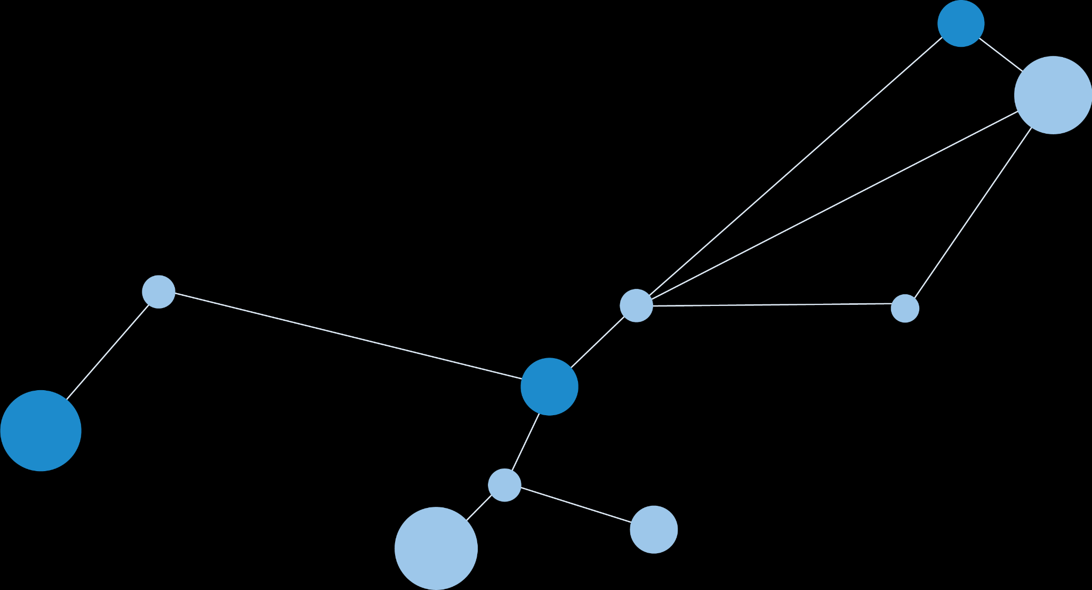



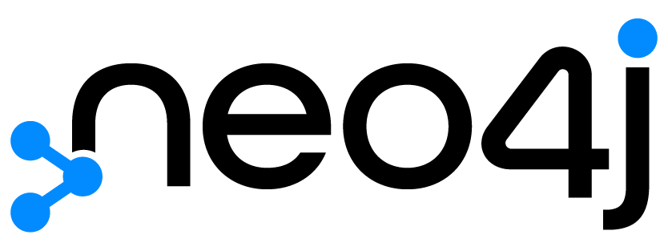
By 2025, graph will be used in 80% of data and analytics innovations

Slide 5
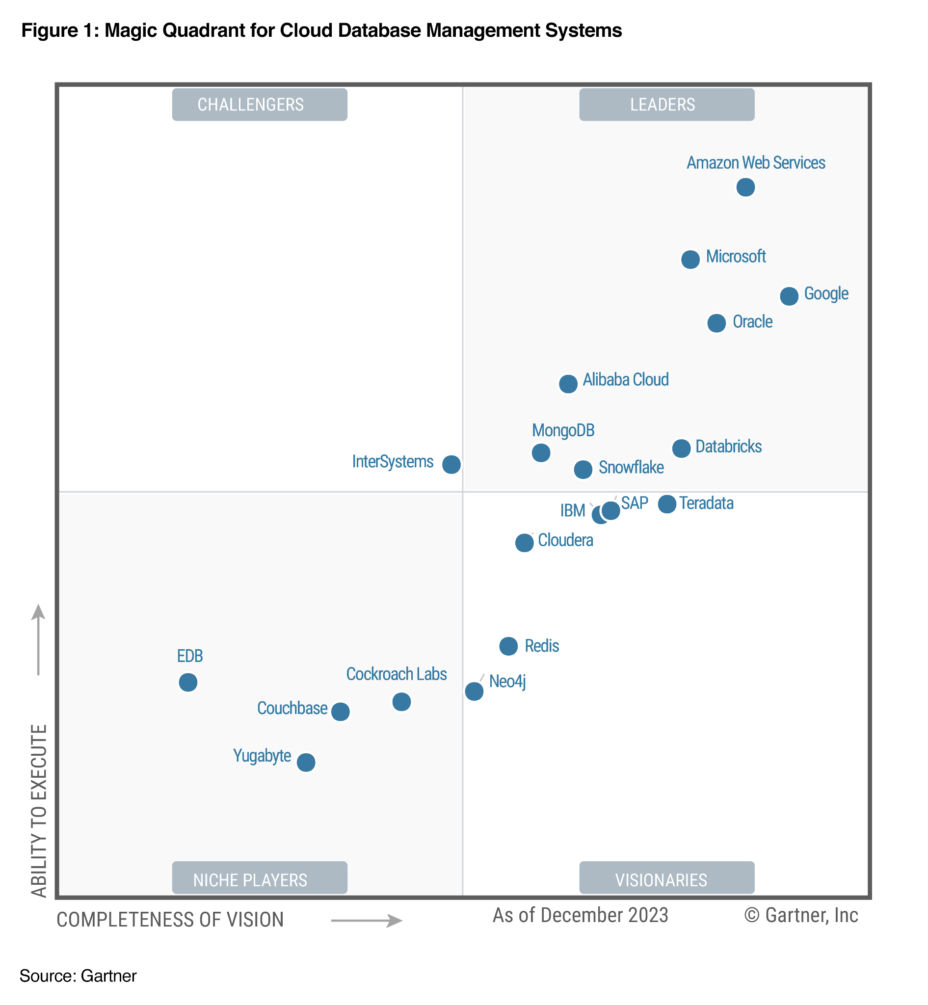
Q4 2023 Gartner Magic Quadrant for Cloud DBMS
Neo4j Named a Visionary in December 2023 Gartner® Magic Quadrant™ for Cloud Database Management Systems
Gartner, Magic Quadrant for Cloud Database Management Systems, 18 December 2023, Adam Ronthal et.
GARTNER is a registered trademark and service mark of Gartner, Inc. and/or its affiliates in the U.S. and internationally, MAGIC QUADRANT is a registered trademark of Gartner, Inc. and/or its affiliates and are used herein with permission. All rights reserved.
Gartner does not endorse any vendor, product or service depicted in this content nor makes any warranties, expressed or implied, with respect to this content, about its accuracy or completeness, including any warranties of merchantability or fitness for a particular purpose. This graphic was published by Gartner, Inc. as part of a larger research document and should be evaluated in the context of the entire document. The Gartner document is available upon request from Neo4j.

Slide 6


is honoured to be awarded the GovTech DSAI Bulk Tender GVT(T)20005 in May 2021 as the only
Graph Data Platform vendor

Slide 7
Company Profile

Slide 8
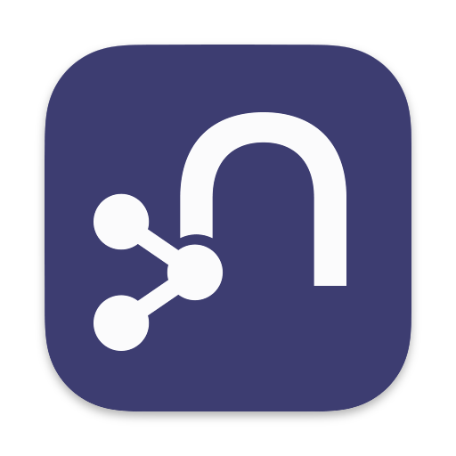















Thousands of organizations trust and use Neo4j
Graph market leader; 1000s of deployments around the globe
20 of the top 25 financial firms 7 of the top 10 retailers
7 of the top 10 software vendors
Global Governments - Civilian, Defense and Intelligence using Neo4j to Analyze, Optimize & Protect
160M+ Downloads
230K+ Devs & Data Scientists
$390M Series F (June 2021)
Largest investment in Database history

Slide 9
What We Do

Slide 10
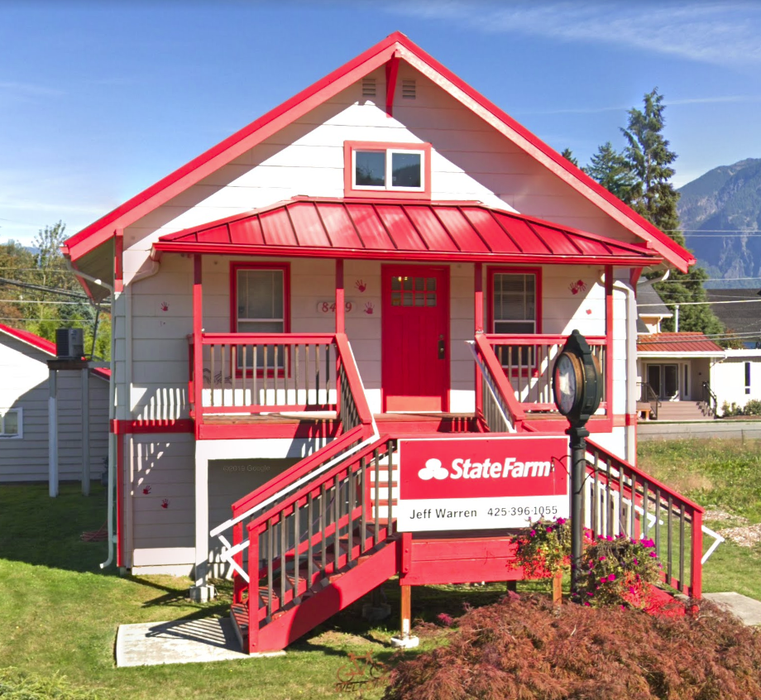

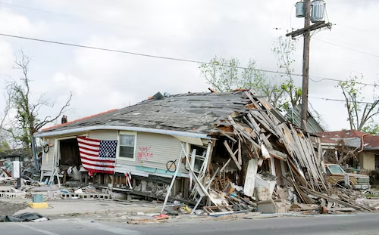




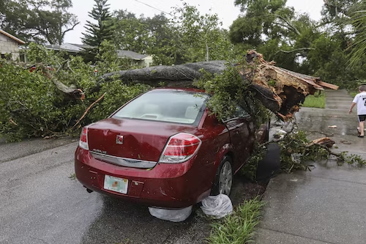
It’s not just numbers, it’s the relationship behind them
AGENTS
GOALS
POLICIES
EVENTS
ASSETS
MARKETS
CLAIMS
RISKS
Notes:
Its not about number of people or entities its the relationship between them. How one thing can relate to another through

Slide 11
Advantages of using Graph
FAST
ELEGANT
EFFICIENT
UNIFYING
INSIGHTFUL
Relationships (and nodes) are stored in memory for real-time access
Complex business processes are simply and faithfully represented
Queries traverse locally-linked objects with consistent performance
Creates a flexible, connected view across disparate data domains
Builds up context, enabling reasoning, inference and predictions
Notes:
Traditional relational databases, although proficient in managing structured data, can struggle when it comes to representing and querying these intricate relationships efficiently.
This structure allows for swift traversal of relationships,

Slide 12
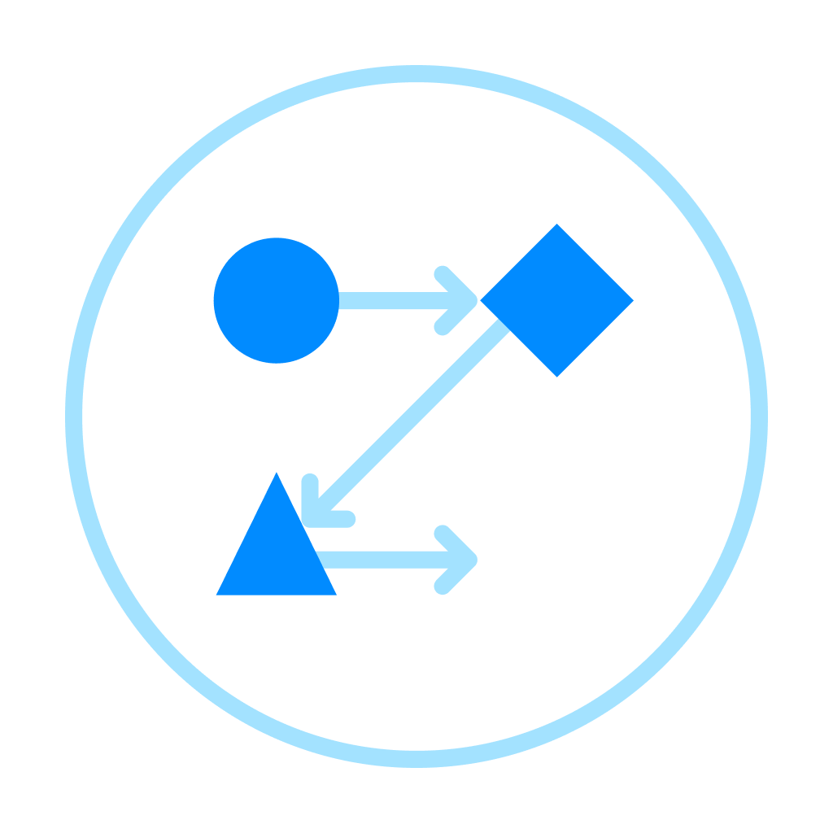

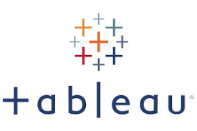
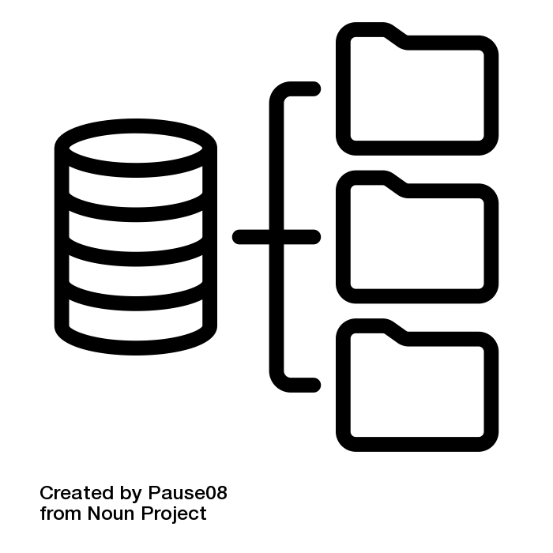
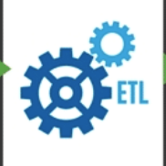
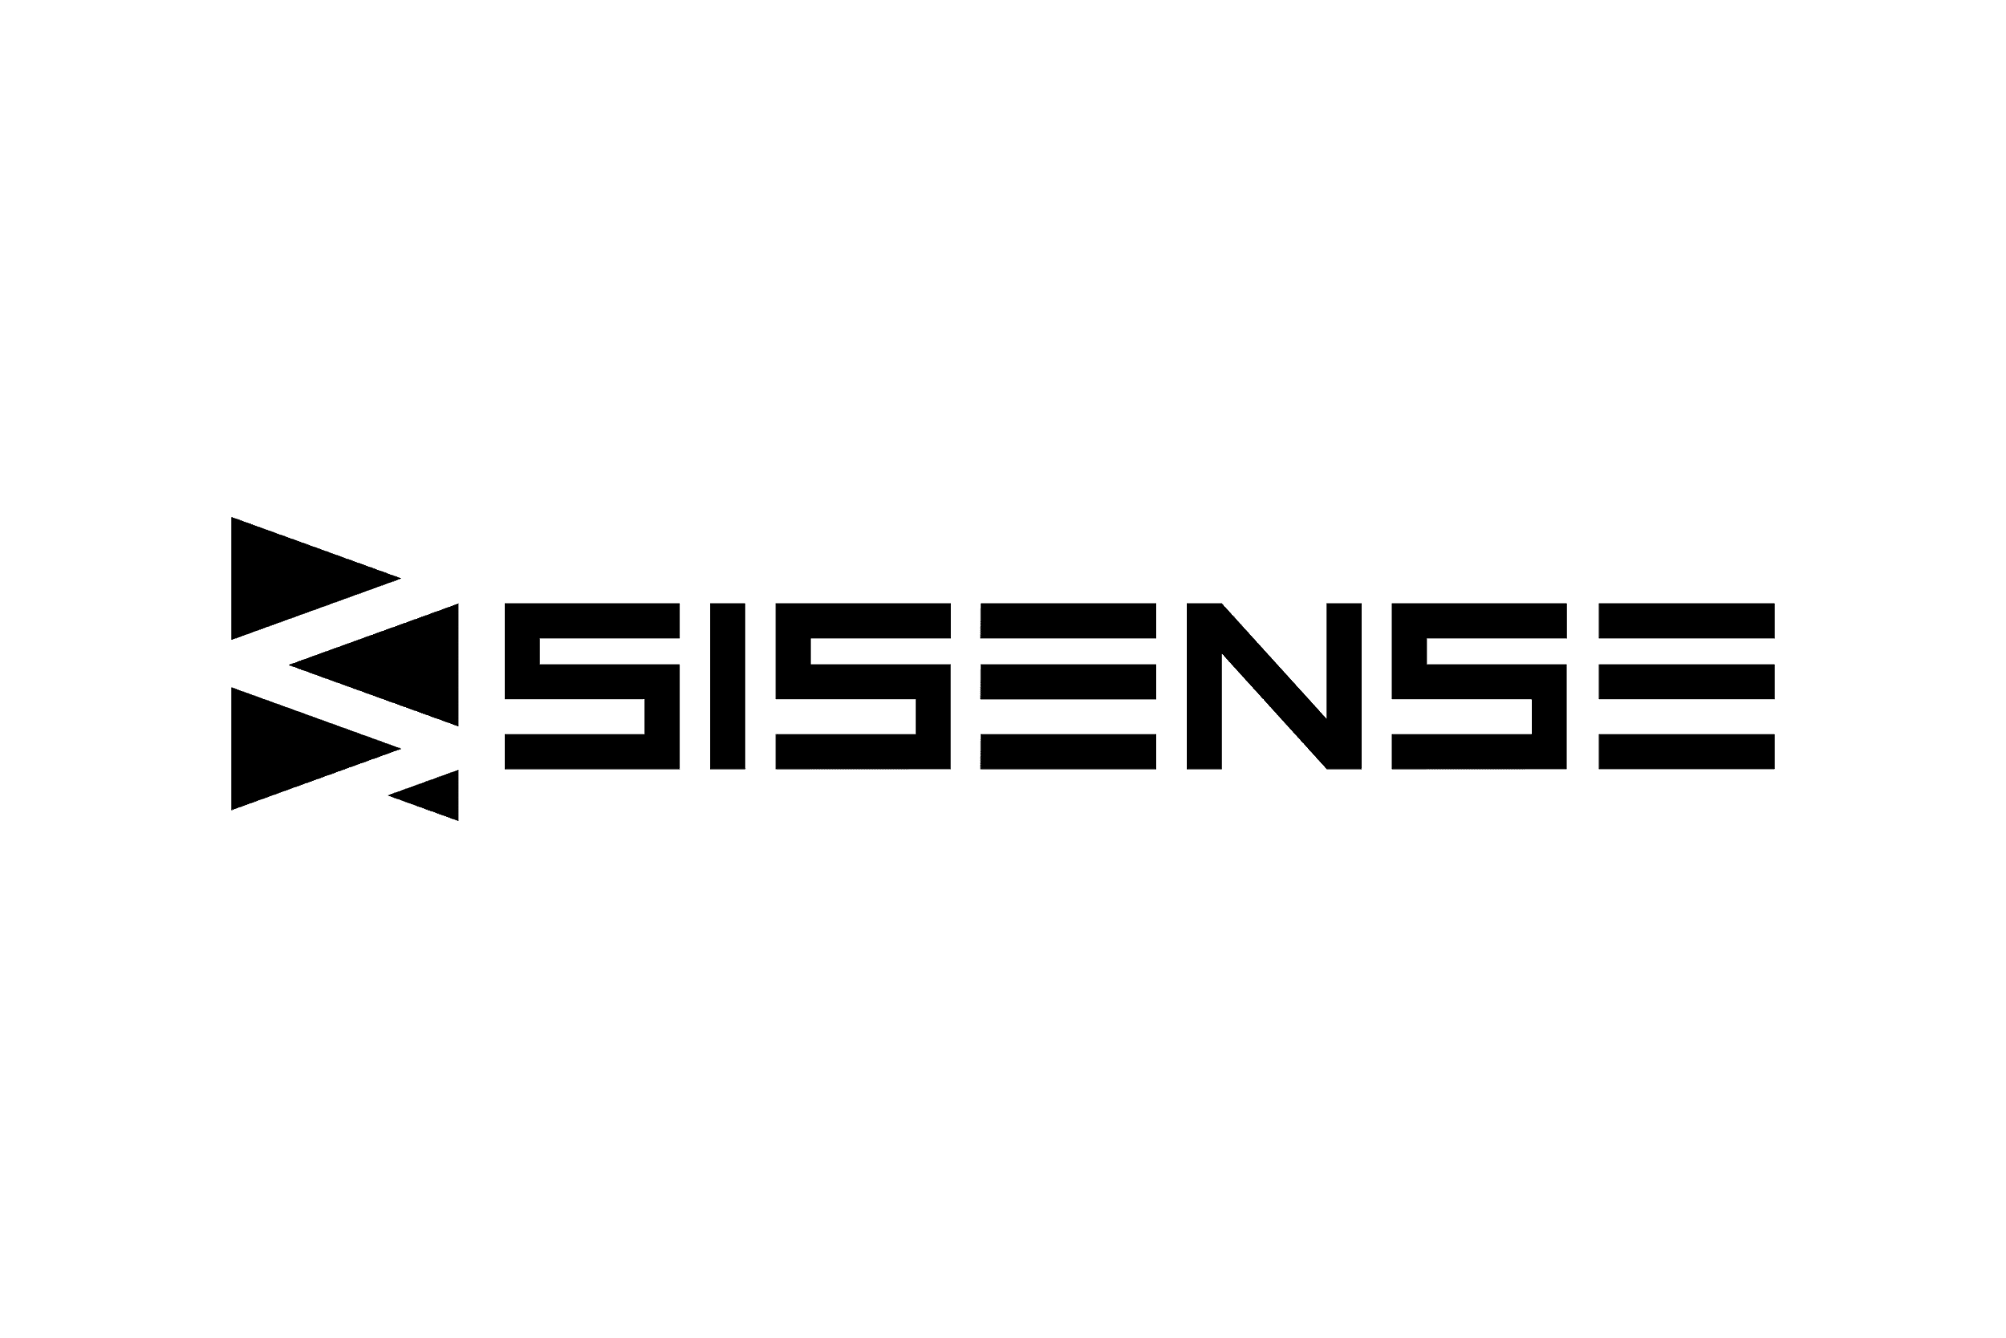


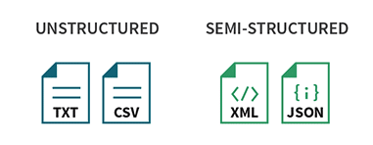



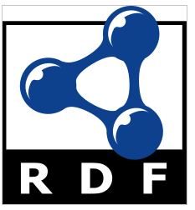

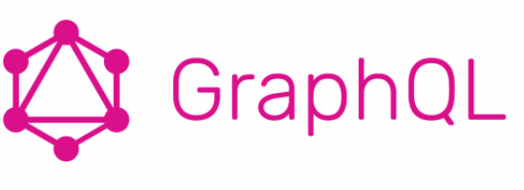



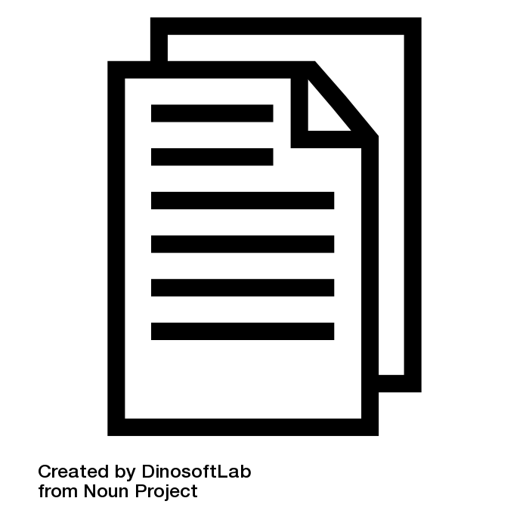

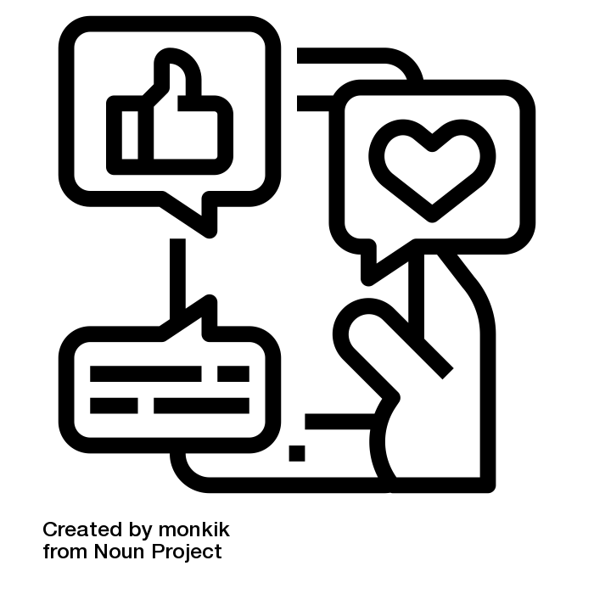



Neo4j Graph Data Platform
DATA SOURCES
INGEST
PRODUCT COMPONENTS
USE CASES
VISUALIZE
Structured
Journey Analytics
Risk Analytics
Churn Analysis
What-if Analysis
DATA ANALYTICS
Neo4j GDS Library
Neo4j Bloom
Apache
Hop
Next Best Case
Feature Engineering & ML
Fraud
DRIVERS & APIs
Recommendations
Data Fabric
Ontologies
Data Compliance
DATA MANAGEMENT
Neo4j Knowledge Graph Workbench
Data Governance
Data Provenance
DEPLOYMENT PLATFORM
Data Lineage
APOC
Unstructured
Notes:
Knowledge graphs as part of the bigger ecosystem.
Data (structured, unstructured, semi-structured) is ingested via different mechanisms eg Neo4j Connector for Apache Spark, HOP, etc
Data is stored, managed and analyzed via Neo4j
Data may go out for further processing:
For Visualization via our BI connector to Tableau, TIbco, etc.
To: GraphQL to connect to other systems
To autoML tools for machine learning processing

Slide 13
Graphs In Government

Slide 14
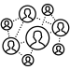


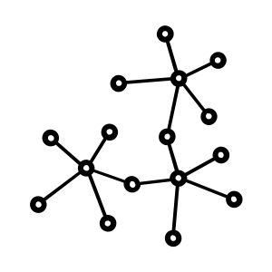

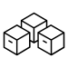

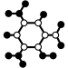


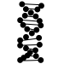




Where we play
Ownership
Oversight
Anti-Money Laundering/Fraud
Network & IT Operations
Risk
Law Enforcement
Asset & Inventory
Management
Resource Mgmt.
Security
Cyber Security
Supply Chain
Intelligence
Graphs in Government
Research
Lessons Learned
Exploration
Science & Education
Planning
Dependency Management
Environment
Consolidation

Slide 15


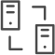
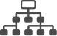

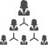




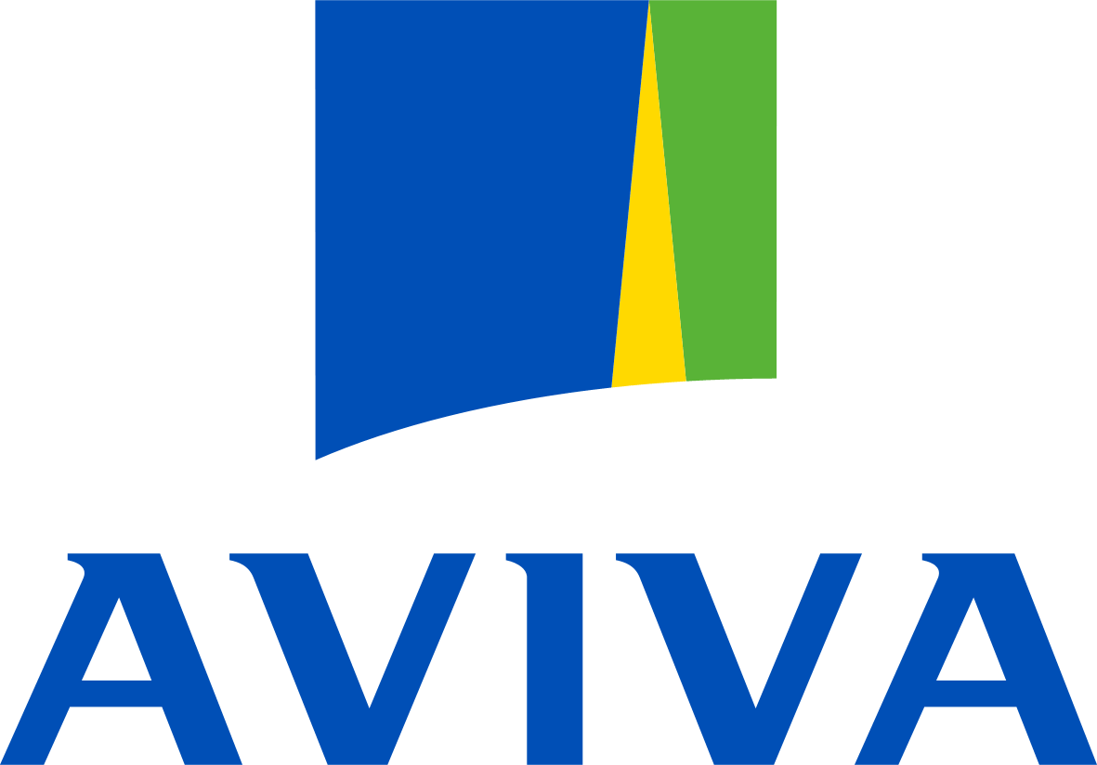








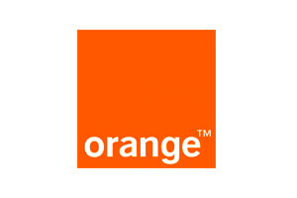






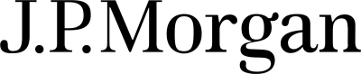

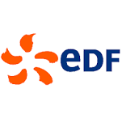















Where we have delivered other use cases
Real-Time Recommendations
Fraud
Detection
Network &
IT Operations
Master Data Management
Risk & Compliance
Identity & Access Management

Slide 16
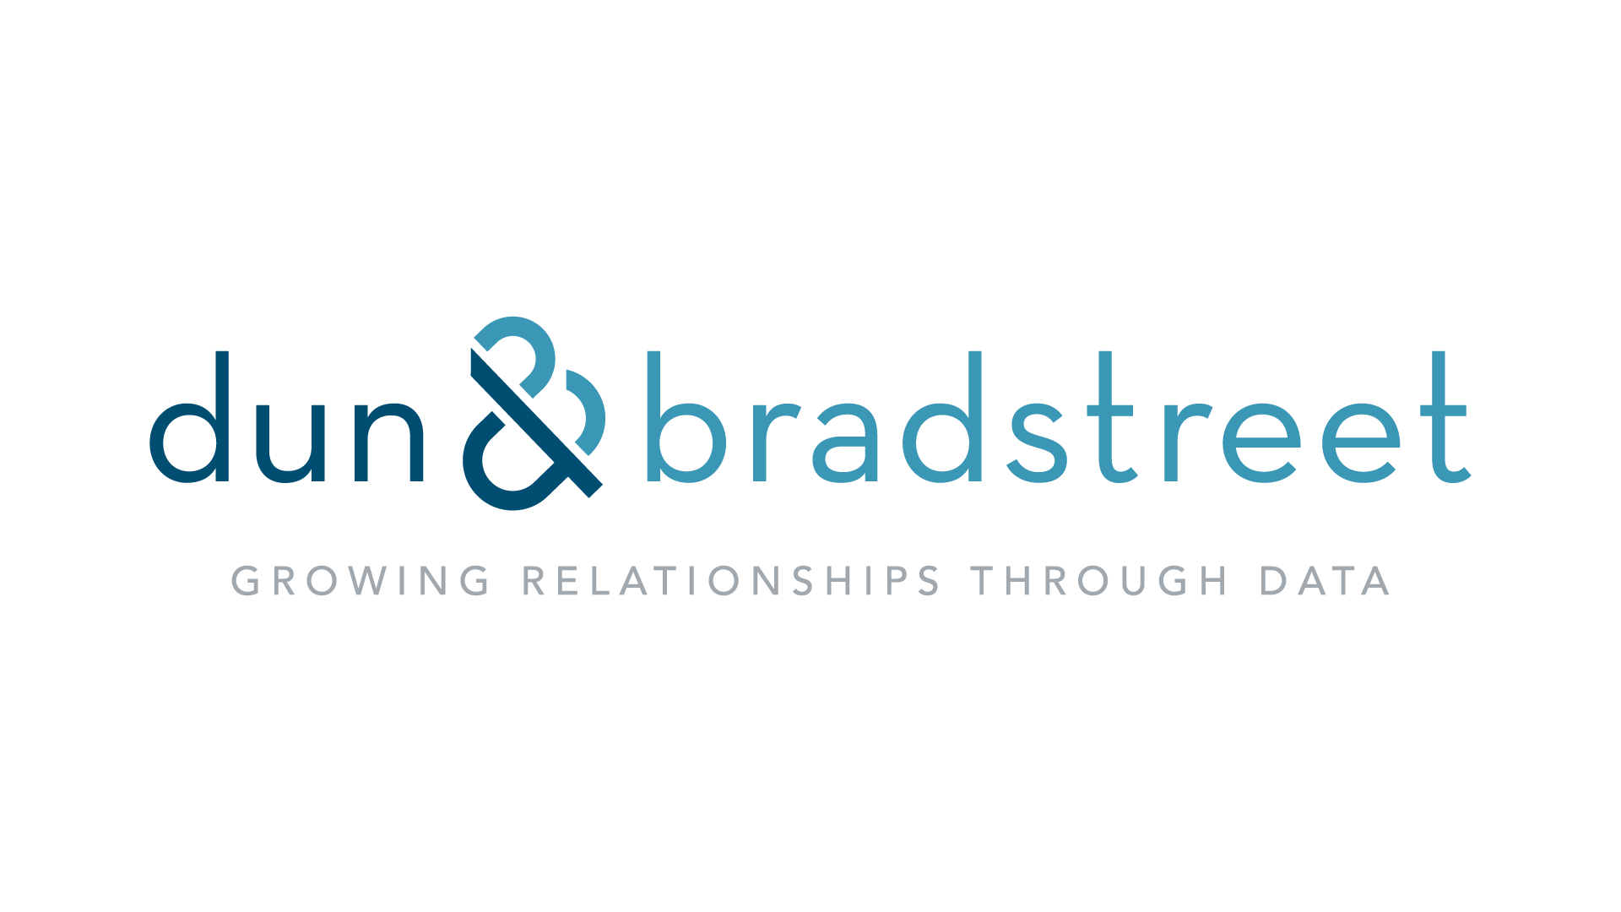
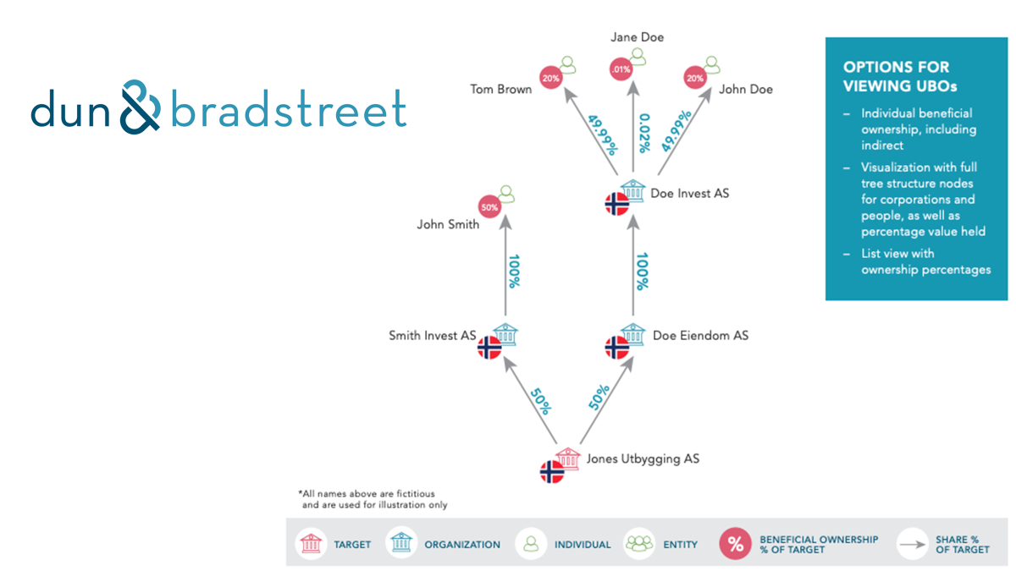
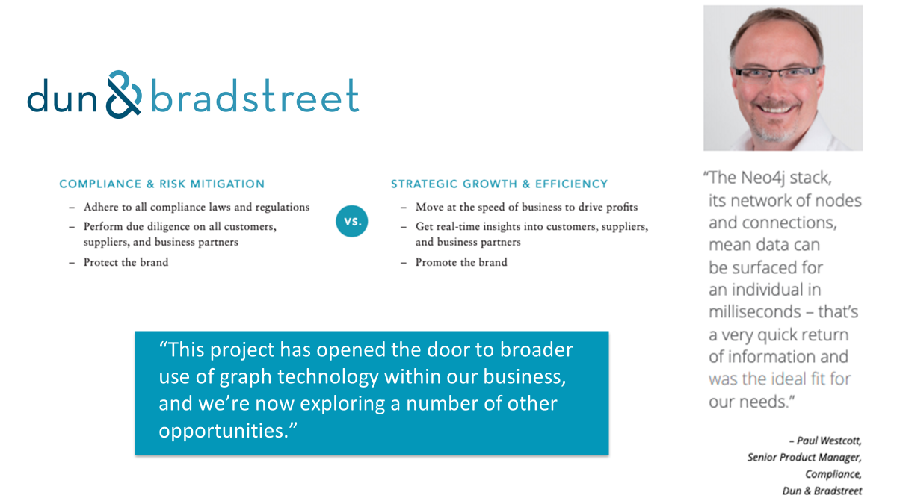
Selected use case:
Compliance with Complex Company Ownership Checks
Highlights
Dun & Bradstreet adopted Neo4j graph technology to enable a new B2B compliance service for organizations that are obliged to investigate all historic company ownership records linked to individuals, in line with new international transparency regulations designed to counter money laundering and tax evasion.

Slide 17

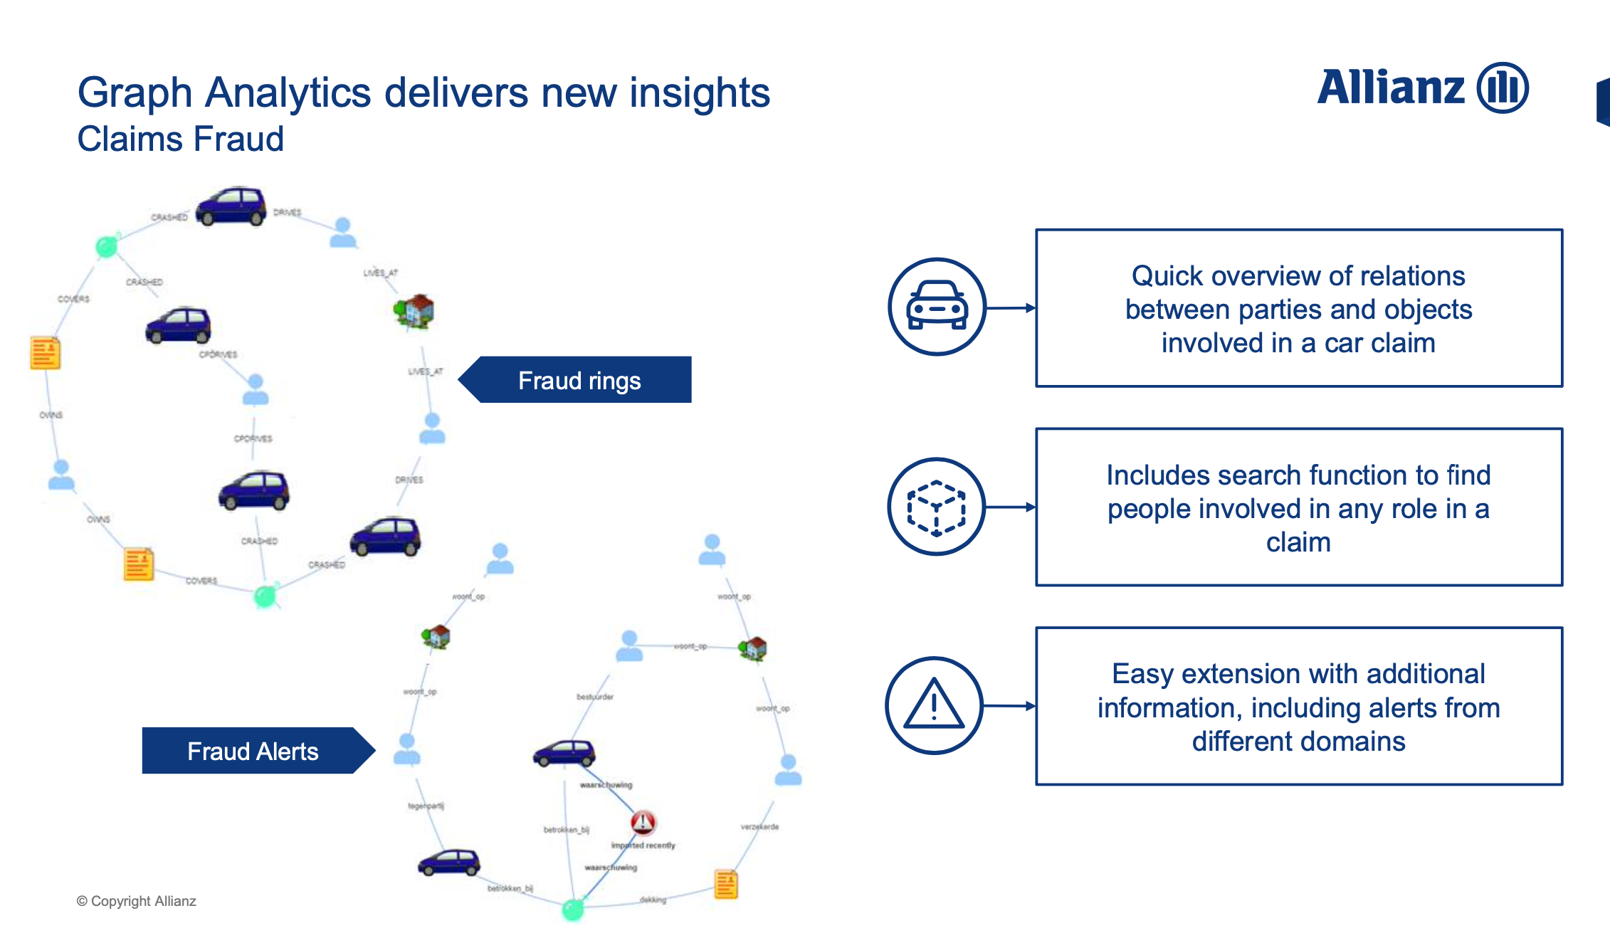
Graph Analytics delivers new insights
Knowledge Graph empowering the business users with Graph Analytics for Applied customer centricity & fraud detection
Start
End
Notes:
What: The staging of automobile accidents, making fictitious and exaggerated injury and damage claims is one of many forms of insurance fraud, including arson, which in sum cost as much as $20 billion a year in direct and indirect losses, the insurance industry has estimated.
Why: Graph analytics enable fraud analysts to quickly analyze complex relationships within insurance data and uncover hidden connections.
Identify patterns and connections….
Between individuals, vehicles and locations involved in suspected fraudulent activities
How: By loading the insurance data to Neo4j, it allow analysts to quickly uncover fraud ring patterns as shown above and use community detection algorithms to identify communities engaged in fraud.

Slide 18
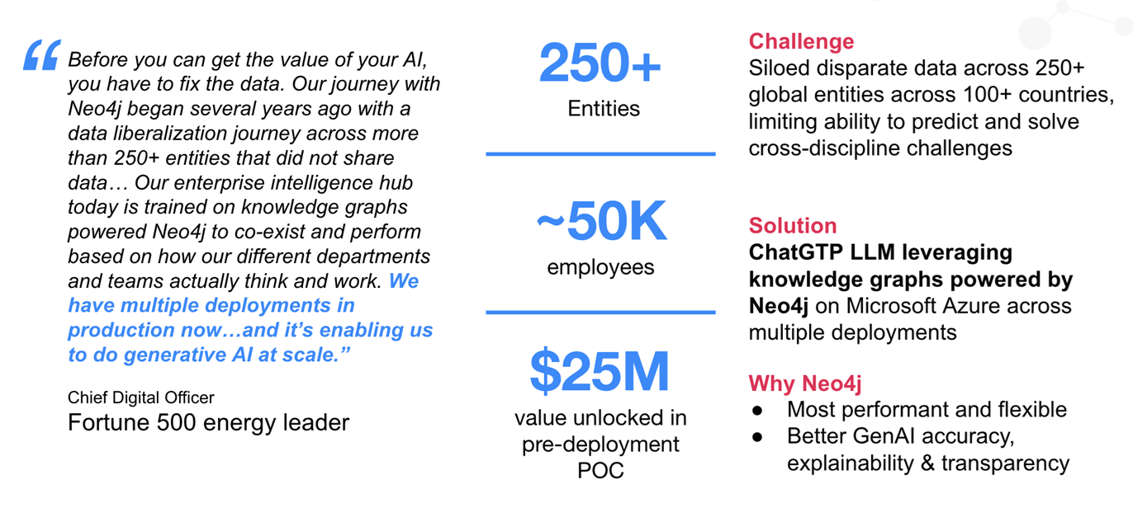
GenAI Deployment in APAC: Fortune 500 Refinery in Asia
ChatGPT LLM leveraging
Notes:
Largest GenAI Deployment in APAC: Fortune 500 Refinery in Asia
Transition: Not only can Neo4j be used the financial or insurance industry…

Slide 19


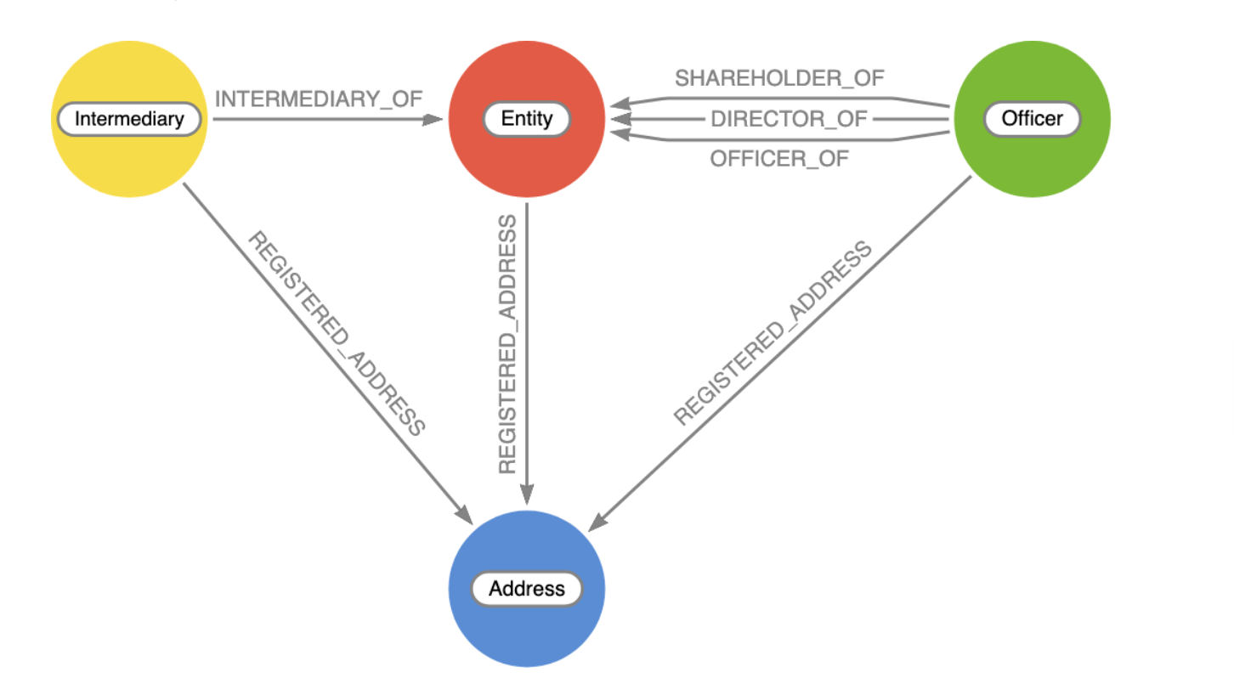
Selected use case:
Revealing Financial Secrets of Global Power Player
Highlights
Panama Papers Graph Model
11.9 million files with different format (structured and unstructured), 2.94 terabytes of data
14 offshore service providers (law firms, banks, etc.)
Oldest documents from 1970, but most between 1996 and 2020
Shell companies in 38 jurisdictions, including the United States for the first time
27,000 shell companies and 29,000 ultimate beneficial owners
130 billionaires (Forbes list)
330 politicians from 90 countries
https://offshoreleaks.icij.org/pages/database
Notes:
Panama papers

Slide 20
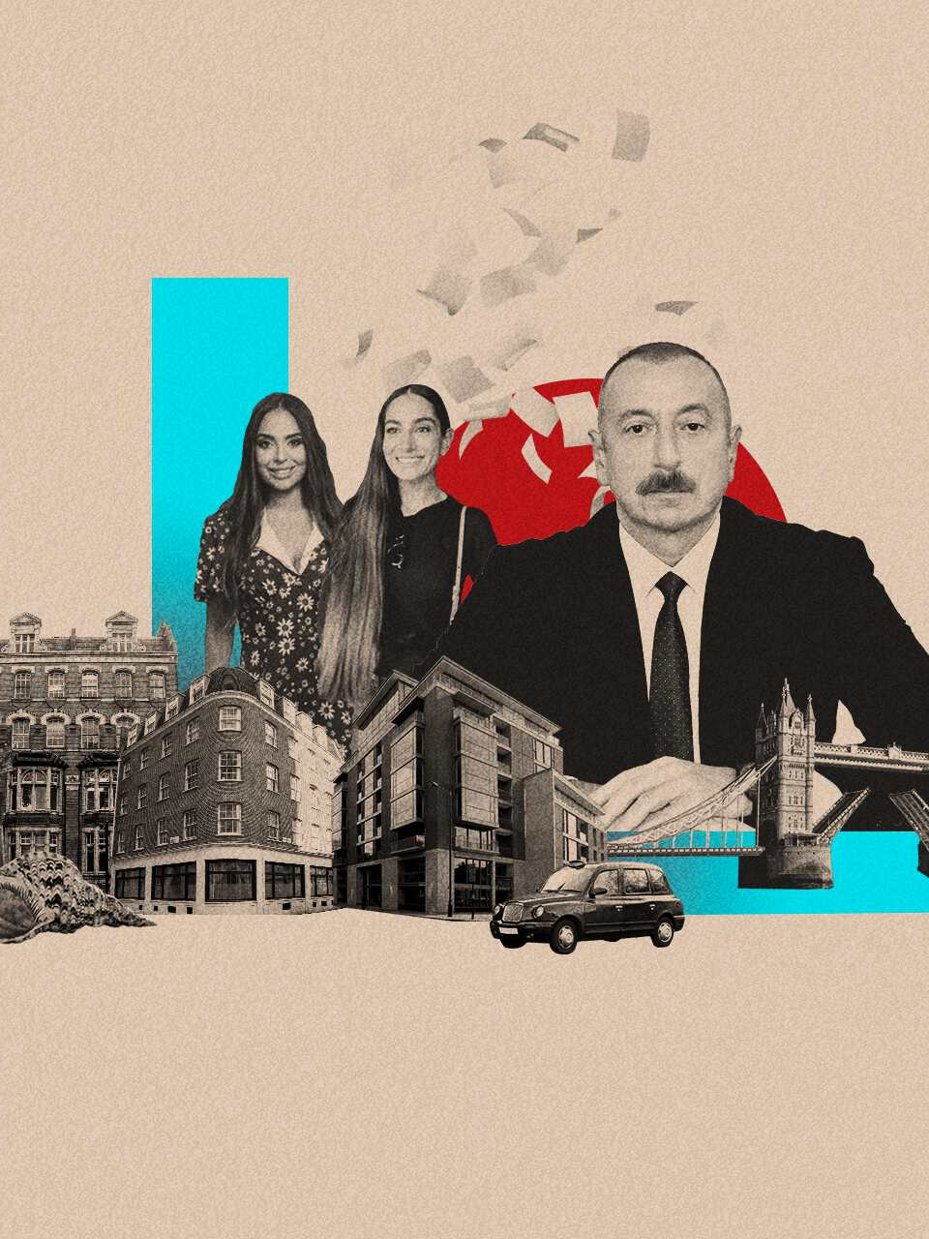
Panama Papers Demo with GenAI
Subject of Interest
Ilham Aliyev
Background
Azerbaijan President
Children
Arzu Aliyeva
Leyla Aliyeva
Heydar Aliyev
Vast network of offshore companies
Uncover Allegations of Corruption
Faced allegations of corruption during presidency
Criticism includes concerns about transparency, human rights, and corruption in the country.
Notes:
Expressive language

Slide 21
Thank You Q & A
Contact us at
teddy.ng@neo4j.com
ken.yap@neo4j.com
bryan.lee@neo4j.com

Slide 22
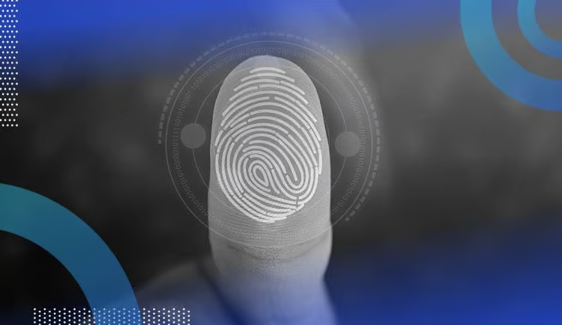
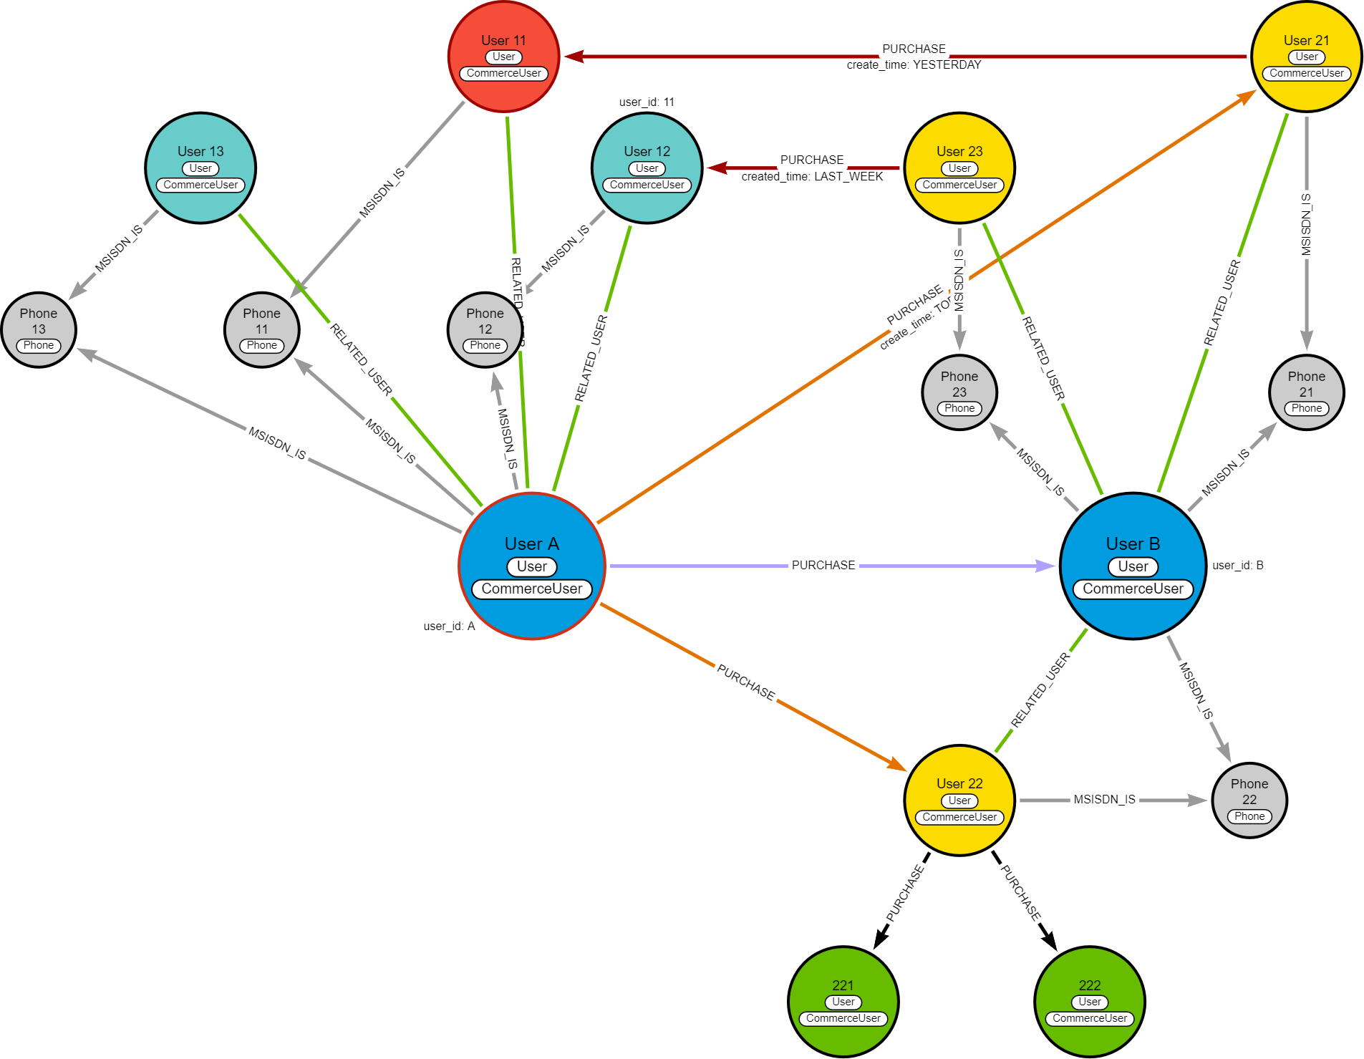
Selected use case:
Real-time fraud detection
Challenge & Why Neo4j:
A major SEA e-commerce customer is using Neo4j Graph to develop fraud detection on vendors subsidies. The Customer is using graph to understand the relational influences of relationship to spot potential fraud with vendors rings.
Result:
Merchant fraud detection in Real-time
Detect related users
Cluster cross-buying fraud detection
Notes:
Not just enterprises, we also have Digital Natives like this e-commerce company in SEA that uses Neo4j for Fraud detection on vendor subsidies.
We could exceed their latency requirement here by a wider range - achieving it in 10 ms against the expected 500 ms.

Slide 23
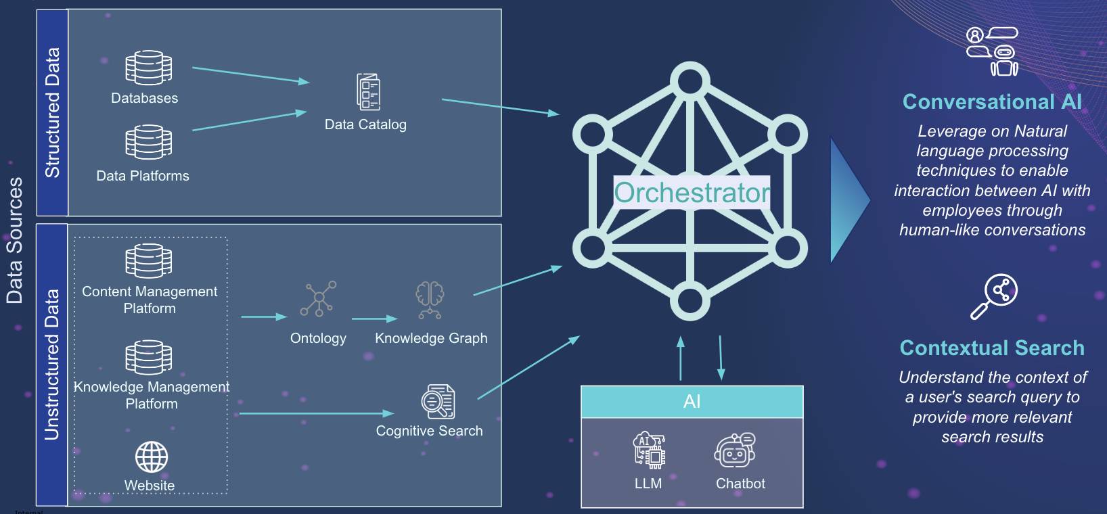
Selected use case:
Breaking down data silos
Use Case
Combined data (e.g. Structured, Semi-structured & Unstructured data like Engineering drawings, design documents) from various silos to build a Knowledge Graph (KG)
Semantic Search & Conversational AI to give cognitive structure to previously dark data
Differentiators
Connected data using KG
Ease of KG enrichment and consumption using LLM
Neo4j’s Interoperability with the Azure ecosystem and Azure OpenAI
Whats next
Master Data Management
Digital Twins
Fraud Detection
Notes:
Let me give more concrete examples based on the four buckets we just saw.
Take this one. This is EDF UC from a Joint customer of ours.
The customer wants to break data silos and build a K. mgmt System. They are leveraging both ACS & Neo4j here. LLMs power the whole pipeline for Natural Language Tasks

Slide 24
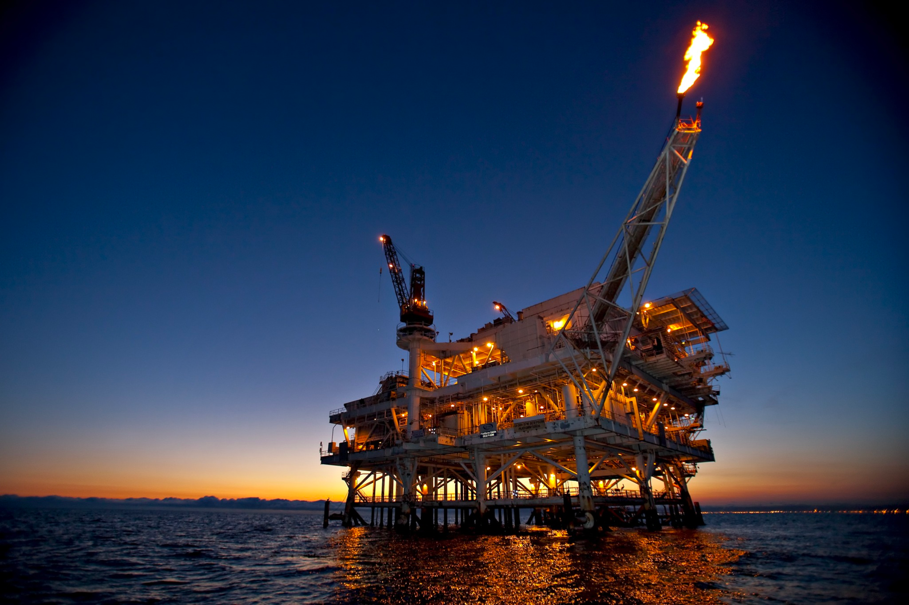
Selected use case:
Oil Exploration, Retrieval Augmented Generation
(RAG)
Challenge:
Disparate data silos in the upstream operations related to geology and geoscience
Complex Relationships and hidden connections
Lack of Unified view
Time and human intensive process
Hallucinations
Why Neo4j:
Graph Database for Enterprise Knowledge Representation
Personalized Experiences with Enterprise Knowledge Graph
Unlock Comprehensive Insights from Connected Data
Complete answers during real time search and decision making
Result:
Reduced hallucination (i.e Grounding)
Context-Aware Retrieval and Generation
Streamlined Decision-Making for oil exploration
Enhanced efficiency in exploring and analyzing geological and geoscientific information
Optimized the quality of responses generated, providing more accurate and context-aware insights
Notes:
Let me give more concrete examples based on the four buckets we just saw.
Take this one. This is EDF UC from a Joint customer of ours.
The customer wants to break data silos and build a K. mgmt System. They are leveraging both ACS & Neo4j here. LLMs power the whole pipeline for Natural Language Tasks

Slide 25
Panama Paper GenAI Demo Artefacts

Slide 26
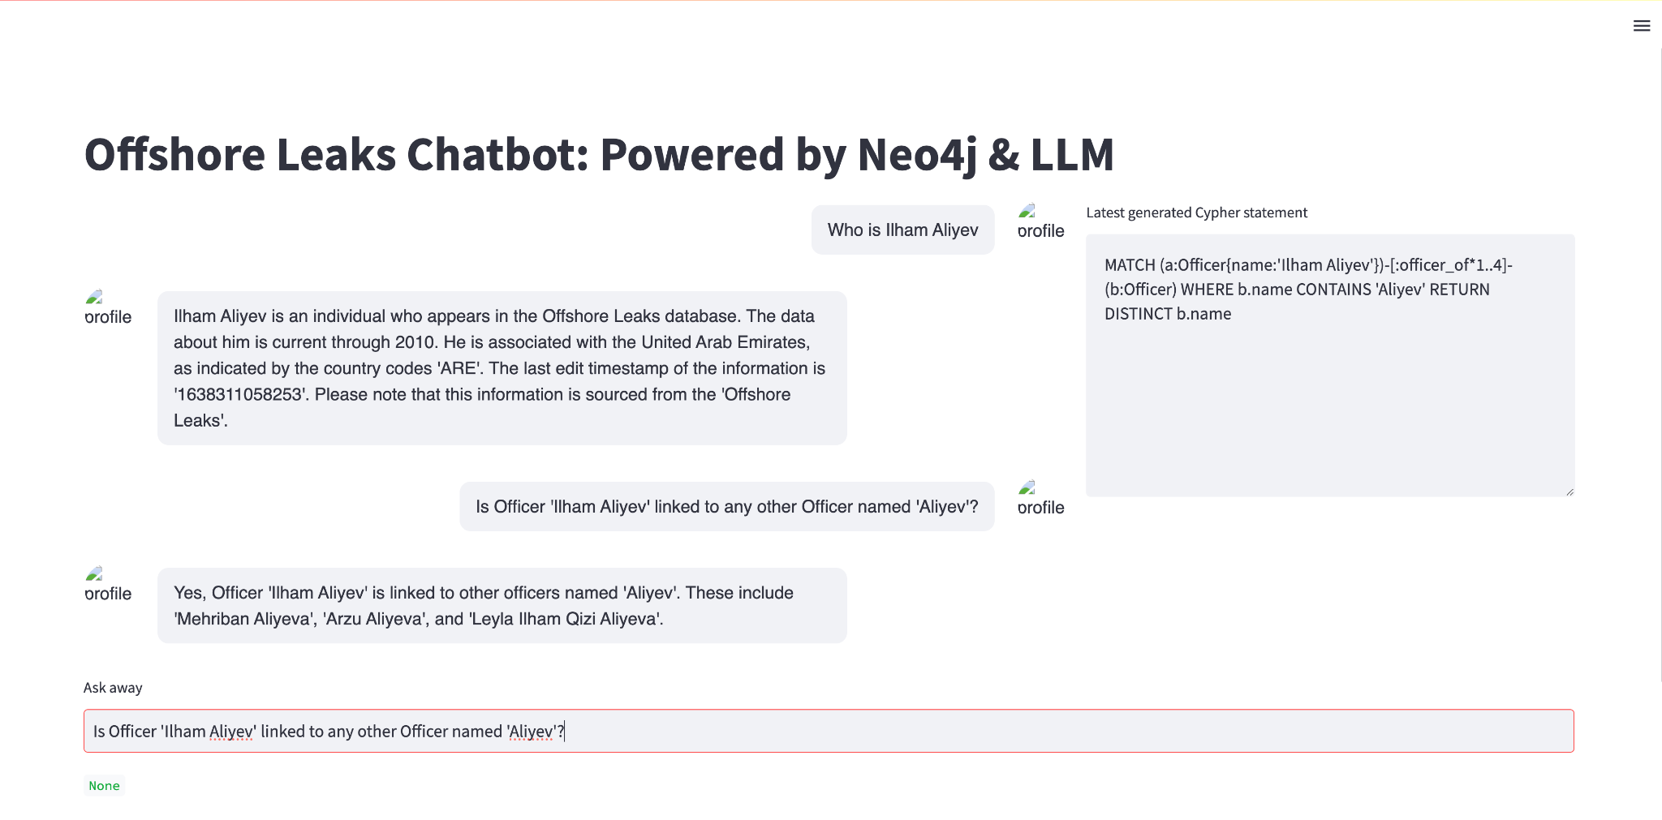
Panama Papers Demo
Cypher language can also be used by technical analyst to validate results
Leveraging Azure OpenAI GPT 4.0 - Prompt and Answers. However, Amazon Bedrock (AWS) LLMs can also be used

Slide 27
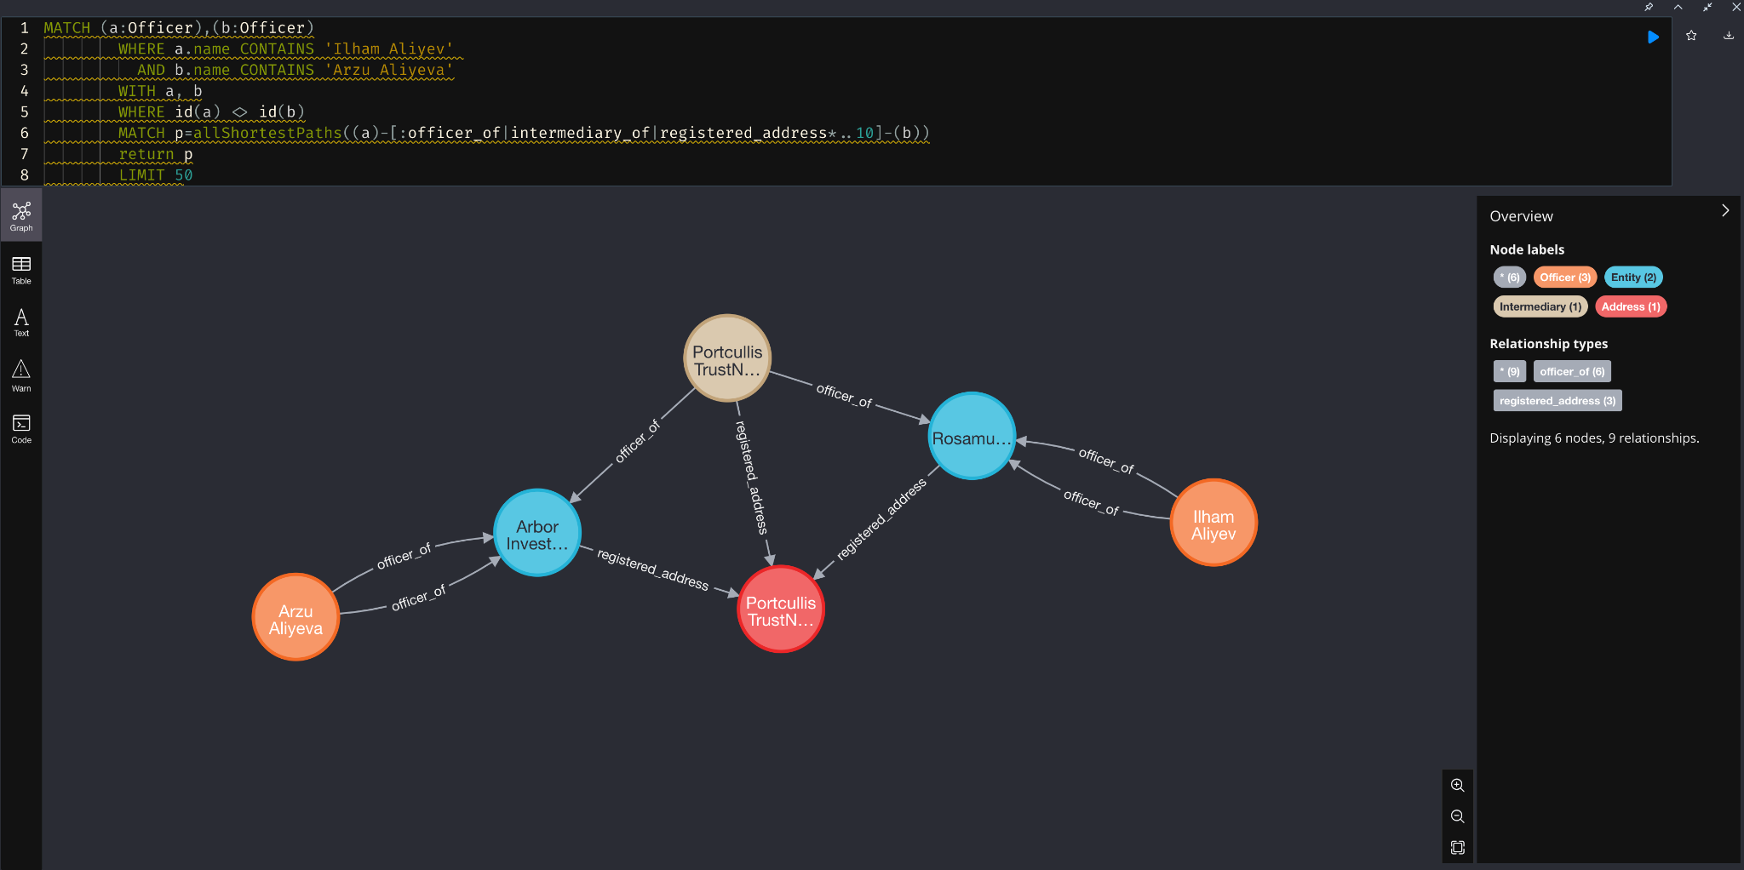
Panama Papers Demo
This is how graph visualization looks like. From here we can see the relationships of the entities

